Slide 1
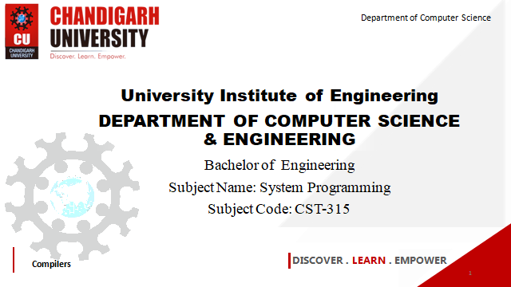

Department of Computer Science
University Institute of Engineering
DEPARTMENT OF COMPUTER SCIENCE & ENGINEERING
Bachelor of Engineering
Subject Name: System Programming
Subject Code: CST-281
Compilers
DISCOVER . LEARN . EMPOWER

Slide 2
Chapter-1.2 Macro
Department of computer Science
Nested Macro Calls
Advanced Macro Facilities
Design Of a Macro Preprocessor

Slide 3
Nested Macro Calls
Nested Macro Definitions
A macro body may also contain further macro definitions. However, these nested macro definitions aren't valid until the enclosing macro has been expanded! That means, the enclosing macro must have been called, before the nested macros can be called.
Example 1:
A macro, which can be used to define macros with arbitrary names, may look as follows:
DEFINE MACRO MACNAME
MACNAME MACRO
DB 'I am the macro &MACNAME.‘
ENDM
ENDM

Slide 4
Nested Macro Calls
In order not to overload the example with "knowhow", the nested macro only introduces itself kindly with a suitable character string in ROM.
The call DEFINE Obiwan
would define the macro
Obiwan MACRO
DB 'I am the macro Obiwan.'
ENDM
and the call DEFINE Skywalker would define the following macro:
Skywalker MACRO
DB 'I am the macro Skywalker.‘
ENDM

Slide 5
Nested Macro Calls
Example 2:
A macro is to insert a variable number of NOPs into the program. For this, a macro with a nested REPT block seems to be best-suited: REPEAT MACRO NOPS
REPT NOPS
NOP
ENDM
ENDM
The macro call REPEAT 4 results in something like that:
Line I Addr Code Source 9+ 1 N 0004 REPT 4
10+ 1 NOP
11+ 1 ENDM
12+ 2 0000 00 NOP
13+ 2 0001 00 NOP
14+ 2 0002 00 NOP
15+ 2 0003 00 NOP

Slide 6
References
John J Donovan Systems Programming Ebook Wordpress (pdflife.one)
[PDF] Systems Programming and Operating Systems by Dhamdhere - Free Download PDF (dlscrib.com)

Slide 7
THANK YOU

